Slide 1
Computer Networking Fundamentals & Configuration
Topics Covered
  Network Types: PAN, LAN, HAN, CAN, MAN, WAN
  Network Hardware
  Wireless Networks
  IPv4 & IPv6 Addressing
  Subnetting
  TCP/IP Settings
  Ports & Protocols
  Network Troubleshooting
  DHCP, DNS & NAT

Slide 2
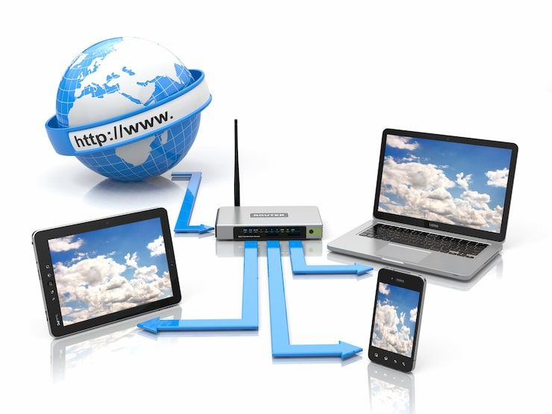
What is a Computer Network?
A computer network is a collection of connected devices that communicate and share resources.

Slide 3
Network Classification
Networks can be classified by geographical coverage, purpose and technology.
PAN — Personal Area Network
LAN — Local Area Network
HAN — Home Area Network
CAN — Campus Area Network
MAN — Metropolitan Area Network
WAN — Wide Area Network

Slide 4
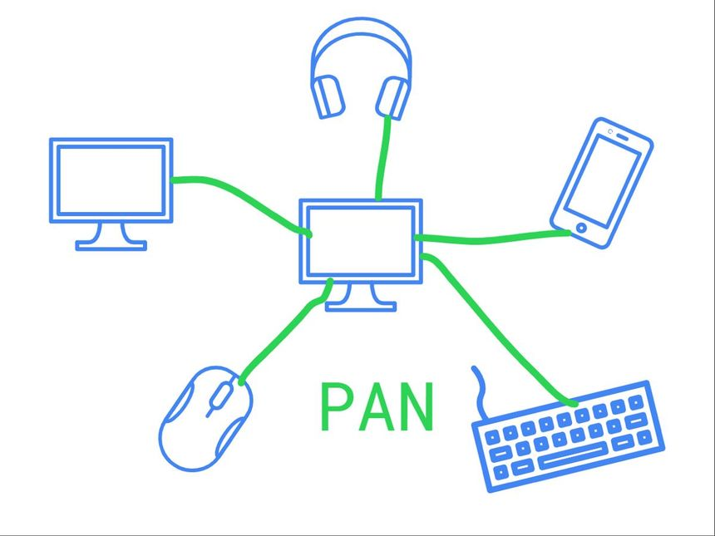
PAN — Personal Area Network
Network around an individual, usually covering a few meters.
Examples
  Smartphone and Bluetooth earbuds
  Laptop and Bluetooth mouse
  Phone and smartwatch
Common technologies: Bluetooth, USB and NFC

Slide 5
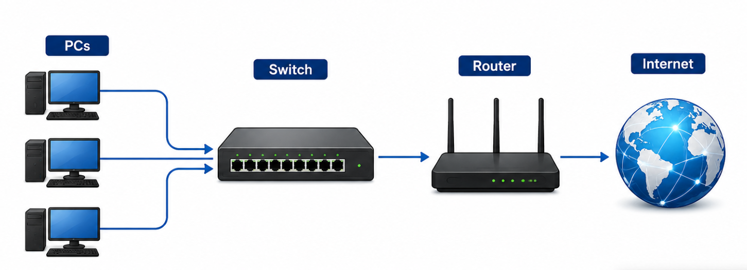
LAN — Local Area Network
Network covering a small geographical area such as a home, office, school or computer lab.
High speed and low latency
Usually privately managed
Common technologies: Ethernet and Wi-Fi
Example: PCs → Switch → Router → Internet

Slide 6
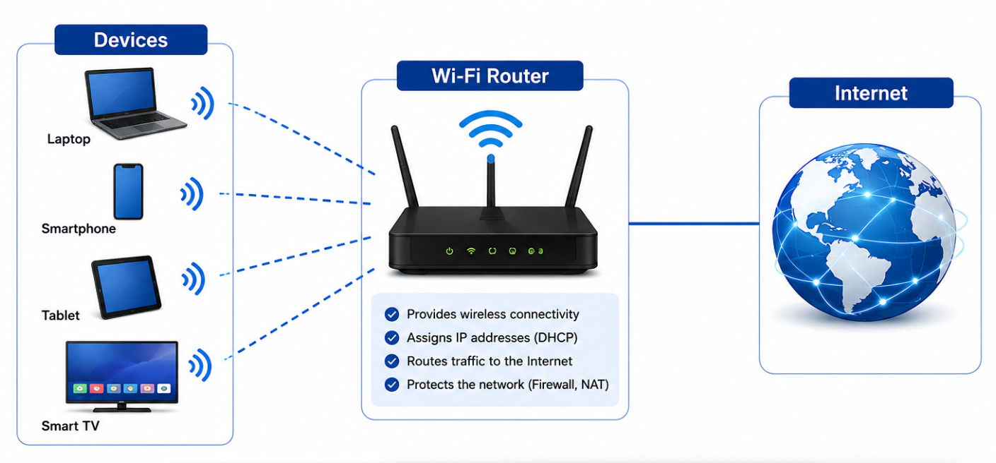
HAN — Home Area Network
Network connecting devices within a home.
Devices: smartphones, laptops, smart TVs, printers and IoT devices
Typical architecture: Devices → Wi-Fi Router → Internet

Slide 7
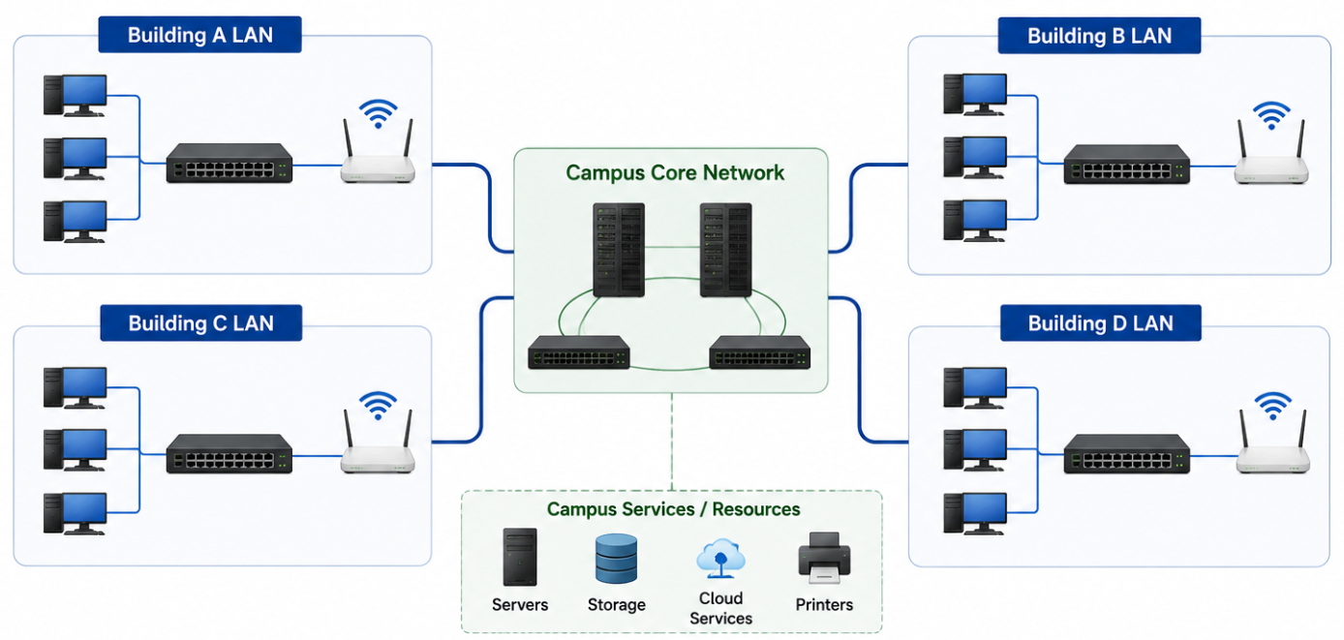
CAN — Campus Area Network
Connects multiple LANs across a campus.
Examples: universities, corporate campuses, hospitals and research facilities
Larger than a LAN but smaller than a MAN or WAN
Typical architecture: Building LANs → Campus Core Network

Slide 8
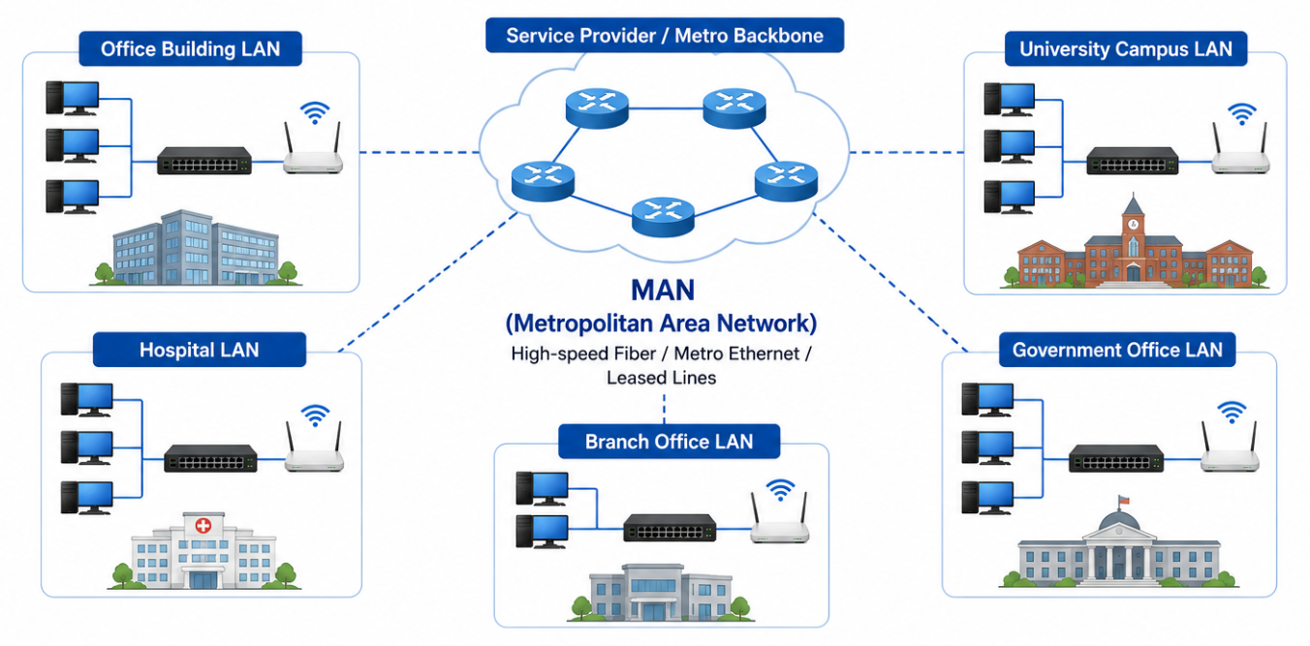
MAN — Metropolitan Area Network
Connects networks across a city or metropolitan area.
Examples: city-wide university networks, ISP metropolitan networks and government networks
Often uses high-speed fiber
Larger than LAN and smaller than WAN

Slide 9
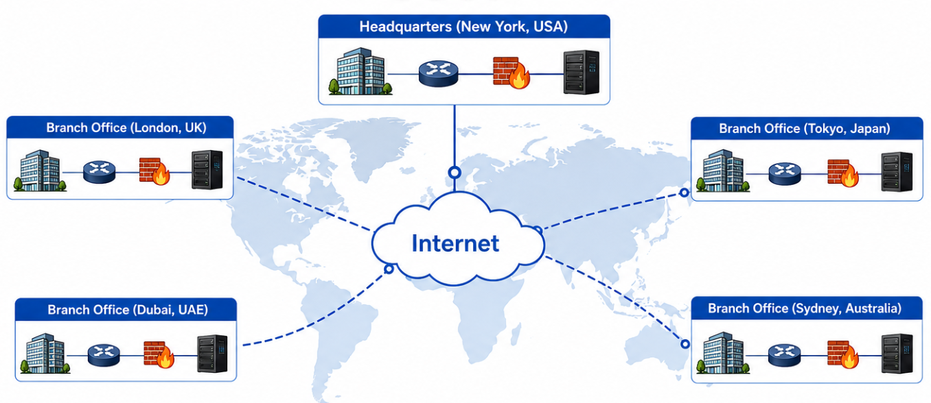
WAN — Wide Area Network
Connects networks across large geographical areas.
Examples: Internet, bank branches and multinational companies
Technologies include fiber, MPLS, leased lines, cellular and satellite
Example: Delhi Office → WAN → Mumbai Office → WAN → Singapore Office

Slide 10
LAN vs MAN vs WAN
LAN: building or local area; high speed; commonly privately managed
MAN: city or metropolitan area; connects multiple LANs
WAN: country or global area; connects geographically distant networks

Slide 11

Network Hardware
Router
Switch
Modem / ONT
Wireless Access Point
Network Interface Card (NIC)
Firewall
Hub
Patch Panel
Network Cables

Slide 12
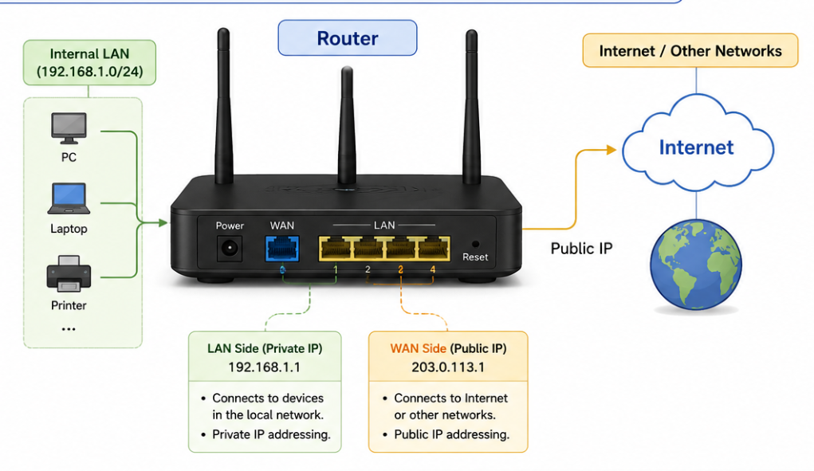
Router
Connects different IP networks and forwards packets between them.
Main functions
  Routing Table
  Firewall
  NAT (Network Address Translation)
Key idea: a switch primarily connects devices within a LAN; a router connects different networks.

Slide 13
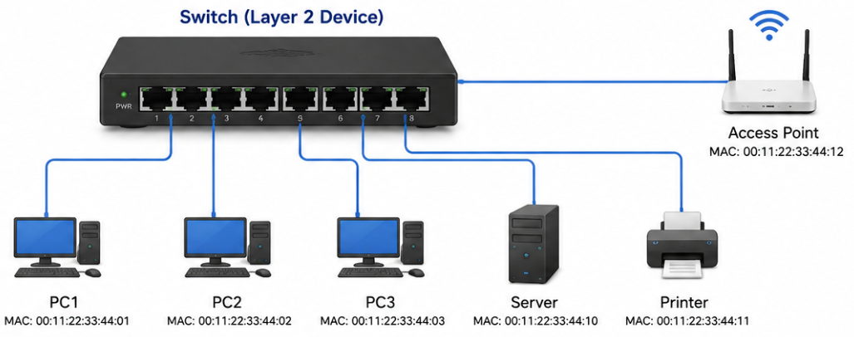
Switch
Connects devices within a LAN.
Key Features:
  Port Mirroring
  VLAN Support
Examples: PCs, servers, printers and access points
Uses MAC addresses and forwarding information to send Ethernet frames toward the destination.

Slide 14
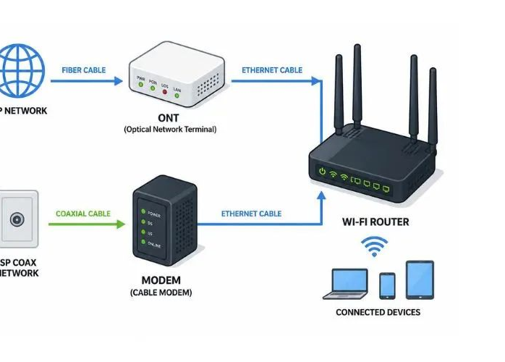
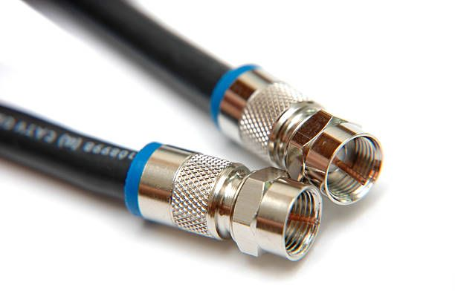
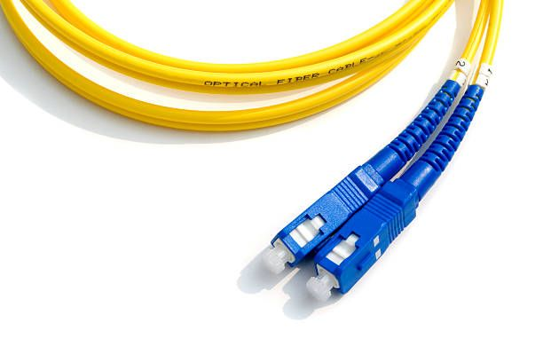
Modem / ONT
Modem means Modulator-Demodulator and interfaces with the ISP's transmission technology.
Examples: DSL modem, cable modem, fiber ONT and cellular modem
Typical path: Computer → Router → Modem/ONT → ISP
Modern ISP devices may combine modem/ONT, router and Wi-Fi functions.

Slide 15
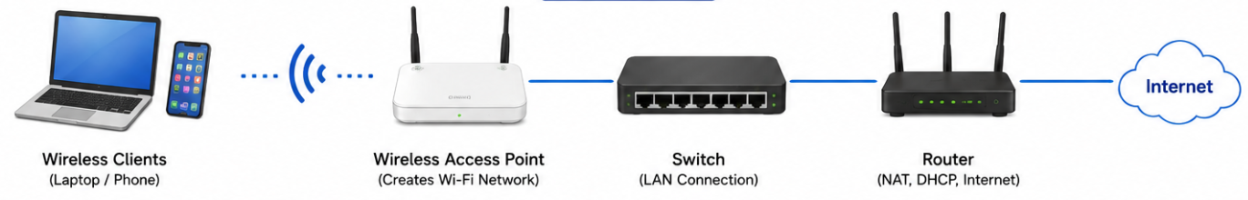
Wireless Access Point
Provides wireless connectivity to a wired network.
Creates a Wi-Fi network
Connects wireless clients to the LAN
Provides wireless authentication and bridges traffic to the wired network
Example: Laptop/Phone → Access Point → Switch → Router

Slide 16
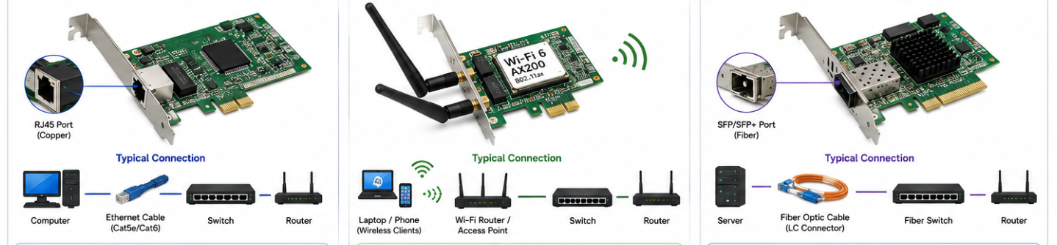
NIC — Network Interface Card
Allows a device to connect to a network.
Types: Ethernet NIC, Wi-Fi NIC and fiber NIC
A network interface normally has a MAC address.
Example MAC address: 00:1A:2B:3C:4D:5E

Slide 17
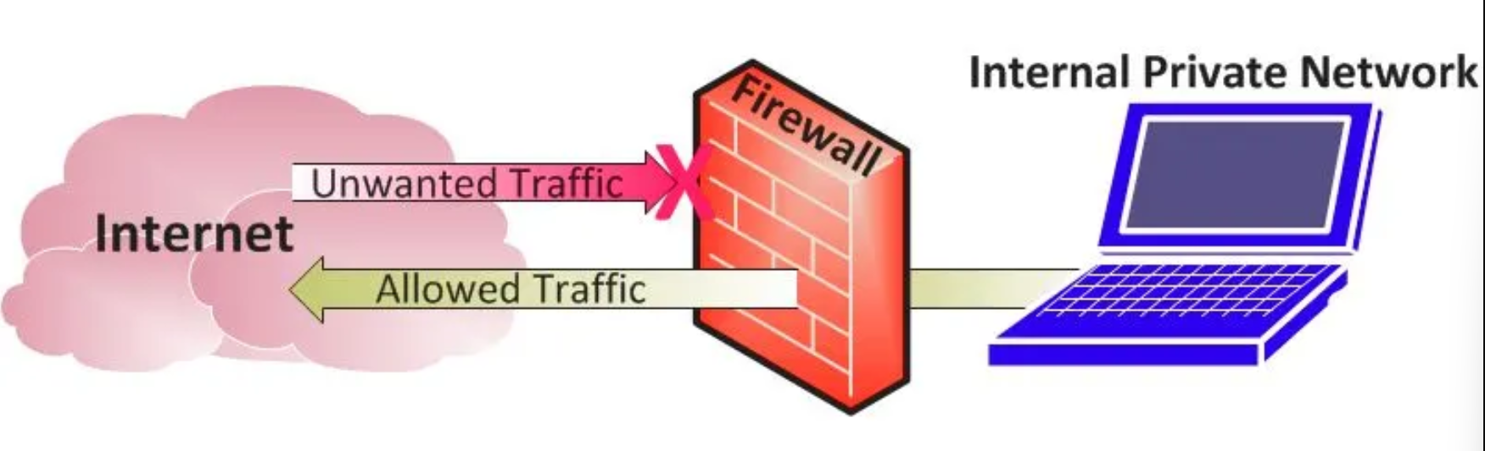
Firewall
Controls network traffic according to security rules.
Rules can use source IP, destination IP, port, protocol and connection state.
Example: Allow TCP 443; block TCP 23
Typical position: Internet → Firewall → Internal Network

Slide 18
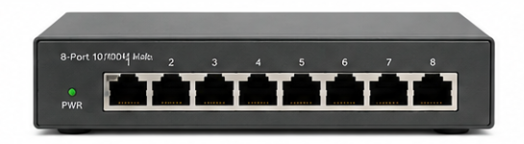
Hub
Basic Layer 1 networking device.
Repeats an incoming signal out of multiple ports.
Does not make the same forwarding decisions as a switch.
Modern LANs use switches instead of hubs.

Slide 19
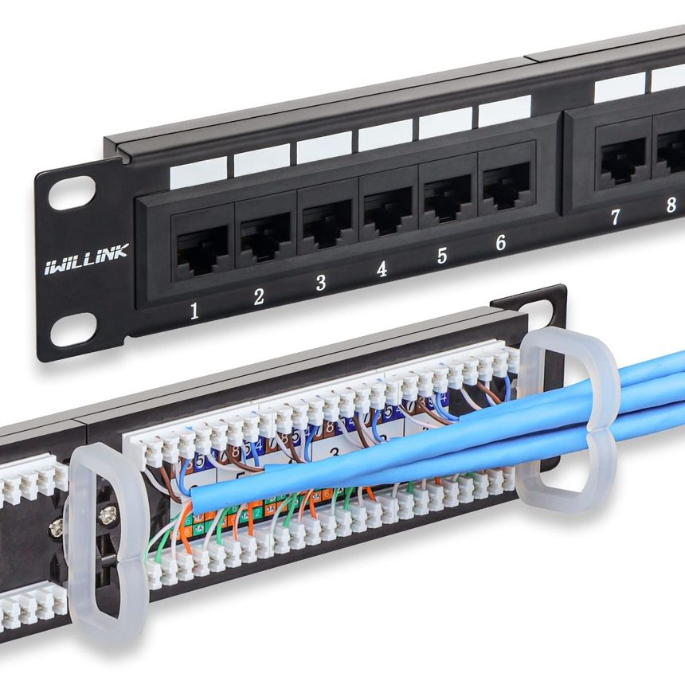
Patch Panel
Provides an organized termination point for network cables.
Benefits
  Cable organization
  Labeling
  Easy maintenance and changes
Typical connection: Wall Cable → Patch Panel → Patch Cable → Switch

Slide 20

Wireless Network Types
Wi-Fi
Bluetooth
Zigbee
Cellular networks: 4G and 5G

Slide 21
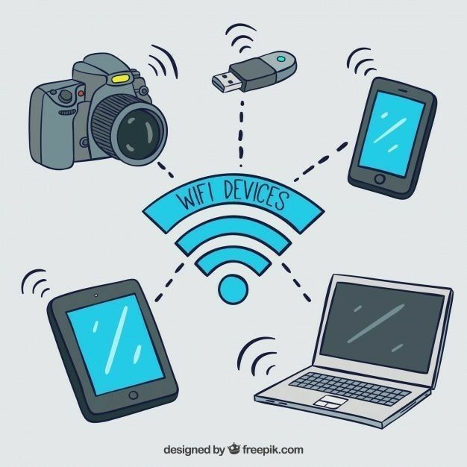
Wi-Fi
Wi-Fi is based on the IEEE 802.11 family of wireless LAN standards.
Uses: Internet access, local networking, streaming and enterprise connectivity
Typical architecture: Device → Wi-Fi AP → Switch → Router → Internet

Slide 22
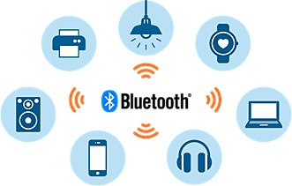
Bluetooth
Short-range wireless technology commonly used for personal connectivity.
Examples: earbuds, keyboard, mouse, smartwatch and car infotainment
Low power and short range
Operates in the 2.4 GHz ISM band
Often considered a PAN technology

Slide 23
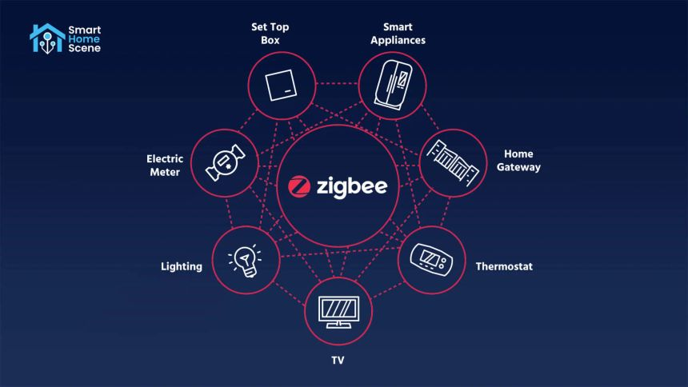
Zigbee
Low-power wireless technology designed for IoT and automation.
Low data rate and low power consumption
Supports mesh networking
Applications: smart lights, sensors, smart locks and home automation

Slide 24
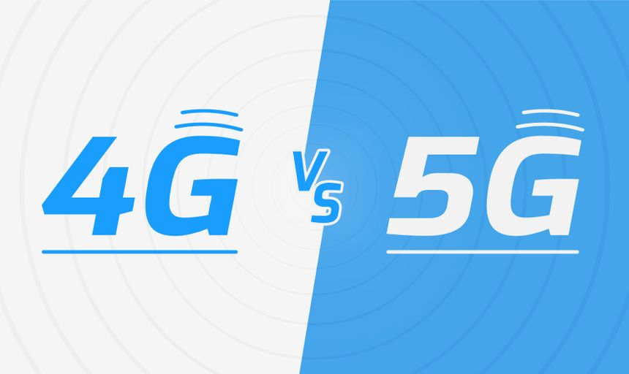
Cellular Networks 4G and 5G
4G
High-speed mobile Internet and LTE-based services
Video streaming and mobile applications
5G
Higher capacity and potentially lower latency
Higher speeds and support for advanced IoT and industrial use cases

Slide 25

What is an IP Address?
An IP address identifies a network interface at the IP layer.
IPv4 uses 32-bit addresses.
  Example: 192.168.1.10
IPv6 uses 128-bit addresses.
  Example: 2001:db8:1234::10

Slide 26
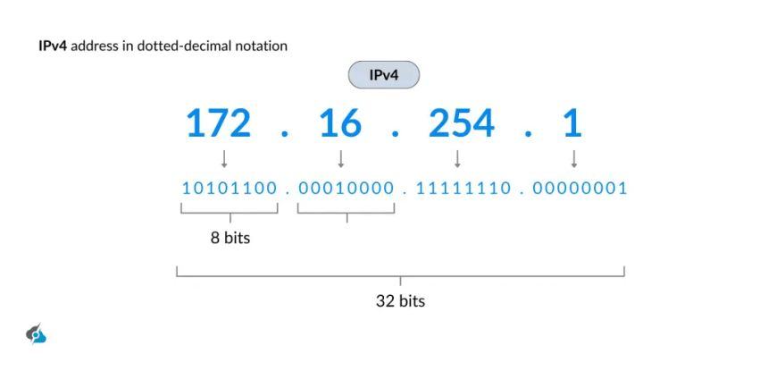
IPv4 Address Structure
IPv4 contains 32 bits.
Written as four 8-bit octets.
Example: 192.168.1.10
Each octet ranges from 0 to 255.

Slide 27
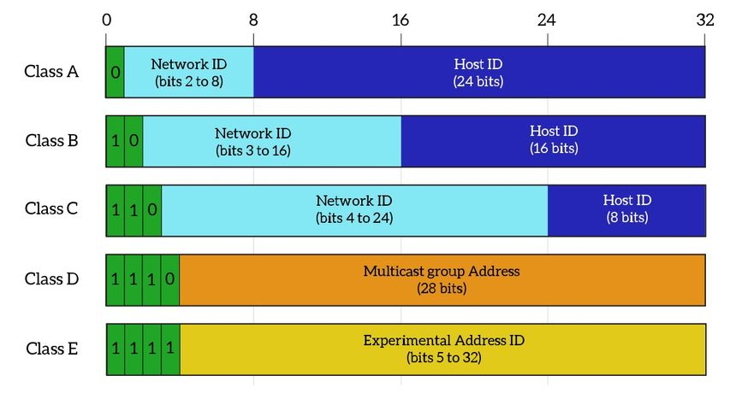
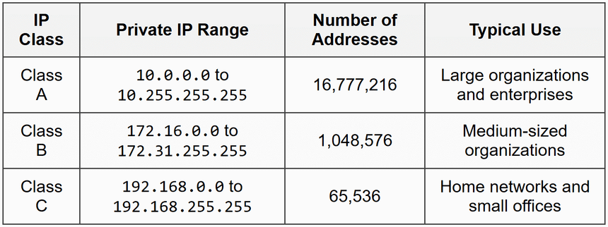
Public vs Private IPv4
Private IPv4 ranges
  10.0.0.0/8
  172.16.0.0/12
  192.168.0.0/16
Private addresses are used inside private networks.
Public IP addresses are globally routable and used for Internet connectivity.
Typical path: Private LAN → NAT → Public IP → Internet

Slide 28
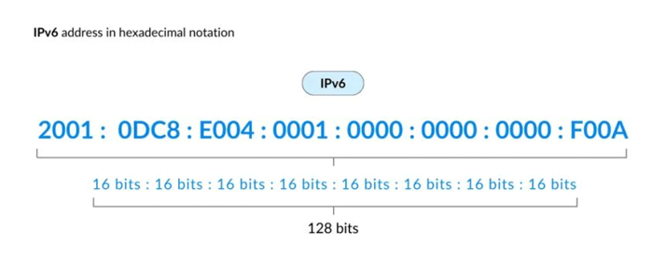
IPv6
IPv6 uses 128-bit addresses.
Example: 2001:db8:abcd:0012::1
Advantages
  Very large address space
  Address autoconfiguration capabilities
  More scalable addressing
IPv6 addresses use hexadecimal notation.

Slide 29
Configure IP Address
IPv4 configuration normally includes
  IP Address
  Subnet Mask
  Default Gateway
  DNS Server
Example
  IP Address: 192.168.1.20
  Subnet Mask: 255.255.255.0
  Default Gateway: 192.168.1.1
  DNS Server: 8.8.8.8
Windows path: Settings → Network & Internet → Adapter Options → IPv4

Slide 30
What is Subnetting?
Subnetting divides a larger IP network into smaller networks.
Benefits
  Efficient IP address utilization
  Better network organization
  Segmentation and management
Example: 192.168.1.0/24 can be divided into smaller subnets.

Slide 31
Subnet Mask & CIDR
CIDR notation represents the number of network bits.
Example: 192.168.1.0/24
/24 means 24 network bits
Subnet mask: 255.255.255.0

Slide 32
Subnetting Example
Network: 192.168.1.0/24
Divide into 4 equal subnets.
New prefix: /26
Subnets
192.168.1.0/26
192.168.1.64/26
192.168.1.128/26
192.168.1.192/26
Each /26 has 64 total addresses and 62 usable host addresses in traditional IPv4 subnetting.

Slide 33
Subnetting Formula
Number of host per subnets = 2^n, where n is the number of borrowed host bits.
Usable hosts per subnet = 2^h − 2, where h is the number of remaining host bits.
Example: /26 leaves 6 host bits.
2^6 − 2 = 62 usable host addresses.

Slide 34
TCP/IP Configuration
Important settings
  IP address
  Subnet mask or prefix length
  Default gateway
  DNS server
TCP/IP communication stack
Application → TCP/UDP → IP → Ethernet/Wi-Fi

Slide 35
Default Gateway
The default gateway is the router used to reach destinations outside the local subnet.
Example: PC 192.168.1.20 → Gateway 192.168.1.1 → Internet
Key question: Where does the PC send traffic when the destination is not local?

Slide 36
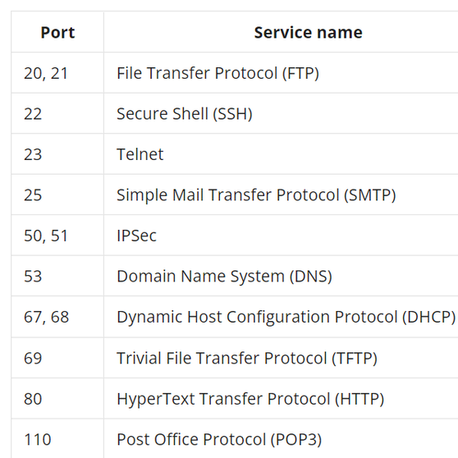
What is a Port?
A port identifies a service or application endpoint at the transport layer.
Port range: 0–65535
0–1023: well-known ports
1024–49151: registered ports
49152–65535: dynamic/private ports

Slide 37
TCP vs UDP
TCP (Transmission Control Protocol)
Connection-oriented
Reliable delivery and retransmission
Examples: HTTPS, SSH and FTP
UDP (User Datagram Protocol)
Connectionless
Does not guarantee delivery by itself
Examples: DNS queries, DHCP and many real-time applications

Slide 38
Common Network Problems
No Internet connectivity
Slow Internet
Limited connectivity
Cannot access a website
DNS resolution failure
IP address conflict
High latency
Packet loss
Wi-Fi disconnections

Slide 39
Network Troubleshooting Methodology
1. Identify the problem
2. Check physical connections
3. Check IP configuration
4. Test local connectivity
5. Test the default gateway
6. Test Internet connectivity
7. Test DNS resolution
8. Check firewall and routing
9. Fix and verify

Slide 40
Useful Windows Network Commands
ipconfig — display IP configuration
ipconfig /all — display detailed network configuration
ping 192.168.1.1 — test connectivity to a host
nslookup google.com — test DNS resolution
tracert google.com — trace the path to a destination
route print — display the routing table
netstat -ano — display network connections and associated process IDs

Slide 41
Troubleshooting Example
Problem: Laptop is connected to Wi-Fi but websites do not open.
Step 1: Check IP configuration with ipconfig.
Step 2: Ping the default gateway.
Step 3: Ping a public IP such as 8.8.8.8.
Step 4: Test DNS with nslookup google.com.
If 8.8.8.8 works but DNS names fail, investigate DNS configuration.

Slide 42
What is DHCP?
DHCP = Dynamic Host Configuration Protocol
Automatically provides network configuration to clients.
Can provide
IP address
Subnet mask
Default gateway
DNS server
Lease information

Slide 43
What is DNS?
DNS = Domain Name System
Converts human-readable names into IP addresses.
Example: google.com → DNS → IP address
Allows users and applications to use names instead of memorizing IP addresses.

Slide 44
DNS Resolution
User enters a domain name.
DNS resolver receives the query.
DNS hierarchy is consulted as needed.
Authoritative DNS provides the requested record.
IP address is returned to the client.
Common DNS records: A, AAAA, CNAME, MX, NS and TXT

Slide 45
What is NAT?
NAT = Network Address Translation
Translates IP addresses between networks.
Common example: private IPv4 address → public IPv4 address
Typical path: 192.168.1.10 → NAT Router → Public IP → Internet

Slide 46
Why NAT?
Allows private IPv4 devices to access the Internet.
Conserves public IPv4 addresses.
Allows multiple private devices to share a public IPv4 address using port translation.
Common types: Static NAT, Dynamic NAT

